Slide 1
Spring Boot Architecture and Fundamentals - Some things to Know for Getting Started With Spring Boot
2021/01/06 Charlotte

Slide 2
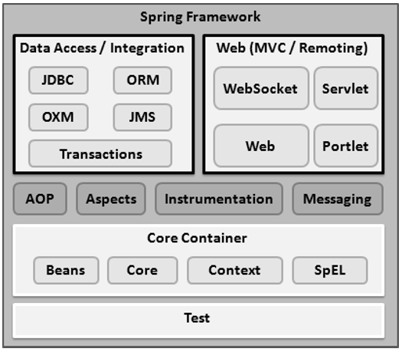
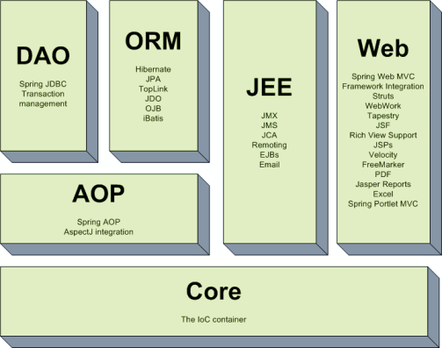
Spring Framework Architecture - Spring is a modular framework
Notes:
https://www.javacodegeeks.com/2019/02/spring-framework-architecture.html
https://www.tutorialspoint.com/spring/spring_architecture.htm
https://dzone.com/articles/spring-framework-architecture
* Core Container
The Core Container consists of the Core, Beans, Context, and Expression Language modules the details of which are as follows −
The Core module provides the fundamental parts of the framework, including the IoC and Dependency Injection features.
The Bean module provides BeanFactory, which is a sophisticated implementation of the factory pattern.
The Context module builds on the solid base provided by the Core and Beans modules and it is a medium to access any objects defined and configured. The ApplicationContext interface is the focal point of the Context module.
The SpEL module provides a powerful expression language for querying and manipulating an object graph at runtime.
* Data Access/Integration
The Data Access/Integration layer consists of the JDBC, ORM, OXM, JMS and Transaction modules whose detail is as follows −
The JDBC module provides a JDBC-abstraction layer that removes the need for tedious JDBC related coding.
The ORM module provides integration layers for popular object-relational mapping APIs, including JPA, JDO, Hibernate, and iBatis.
The OXM module provides an abstraction layer that supports Object/XML mapping implementations for JAXB, Castor, XMLBeans, JiBX and XStream.
The Java Messaging Service JMS module contains features for producing and consuming messages.
The Transaction module supports programmatic and declarative transaction management for classes that implement special interfaces and for all your POJOs.
* Web
The Web layer consists of the Web, Web-MVC, Web-Socket, and Web-Portlet modules the details of which are as follows −
The Web module provides basic web-oriented integration features such as multipart file-upload functionality and the initialization of the IoC container using servlet listeners and a web-oriented application context.
The Web-MVC module contains Spring's Model-View-Controller (MVC) implementation for web applications.
The Web-Socket module provides support for WebSocket-based, two-way communication between the client and the server in web applications.
The Web-Portlet module provides the MVC implementation to be used in a portlet environment and mirrors the functionality of Web-Servlet module.
* Miscellaneous
There are few other important modules like AOP, Aspects, Instrumentation, Web and Test modules the details of which are as follows −
The AOP module provides an aspect-oriented programming implementation allowing you to define method-interceptors and pointcuts to cleanly decouple code that implements functionality that should be separated.
The Aspects module provides integration with AspectJ, which is again a powerful and mature AOP framework.
The Instrumentation module provides class instrumentation support and class loader implementations to be used in certain application servers.
The Messaging module provides support for STOMP as the WebSocket sub-protocol to use in applications. It also supports an annotation programming model for routing and processing STOMP messages from WebSocket clients.
The Test module supports the testing of Spring components with JUnit or TestNG frameworks.

Slide 3
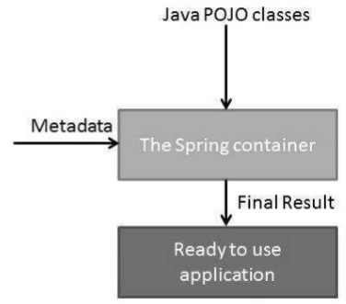
IoC & DI - Inversion of Control & Dependency Inversion
IoC is："Don't call me, I'll call you.“
不要向容器要求您所需要的（物件）資源，容器會自動將這些物件給您！
Notes:
https://openhome.cc/Gossip/SpringGossip/IOC.html

Slide 4
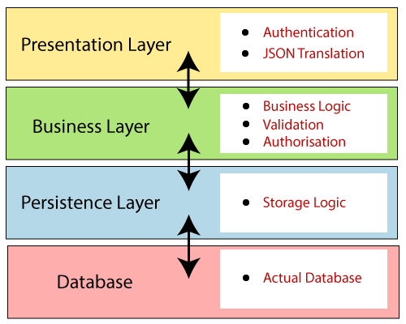
Spring Boot Architecture - Hierarchical Structure (1/3)

Slide 5
Spring Boot Architecture - Hierarchical Structure (2/3)
Presentation Layer: The presentation layer handles the HTTP requests, translates the JSON parameter to object, and authenticates the request and transfer it to the business layer. In short, it consists of views i.e., frontend part.
Business Layer: The business layer handles all the business logic. It consists of service classes and uses services provided by data access layers. It also performs authorization and validation.
Persistence Layer: The persistence layer contains all the storage logic and translates business objects from and to database rows.
Database Layer: In the database layer, CRUD (create, retrieve, update, delete) operations are performed.

Slide 6
Spring Boot Architecture - Hierarchical Structure (3/3)
Notes:
Now we have validator classes, view classes, and utility classes.
Spring Boot uses all the modules of Spring-like Spring MVC, Spring Data, etc. The architecture of Spring Boot is the same as the architecture of Spring MVC, except one thing: there is no need for DAO and DAOImpl classes in Spring boot.
Creates a data access layer and performs CRUD operation.
The client makes the HTTP requests (PUT or GET).
The request goes to the controller, and the controller maps that request and handles it. After that, it calls the service logic if required.
In the service layer, all the business logic performs. It performs the logic on the data that is mapped to JPA with model classes.
A JSP page is returned to the user if no error occurred.

Slide 7
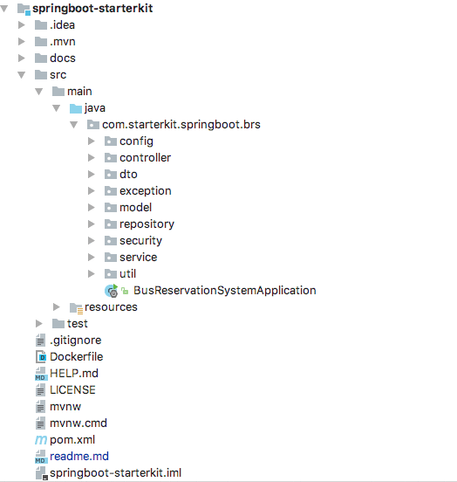
Project Structure and Best Practices
Presentation Layer
Persistence Layer
Business Layer

Slide 8
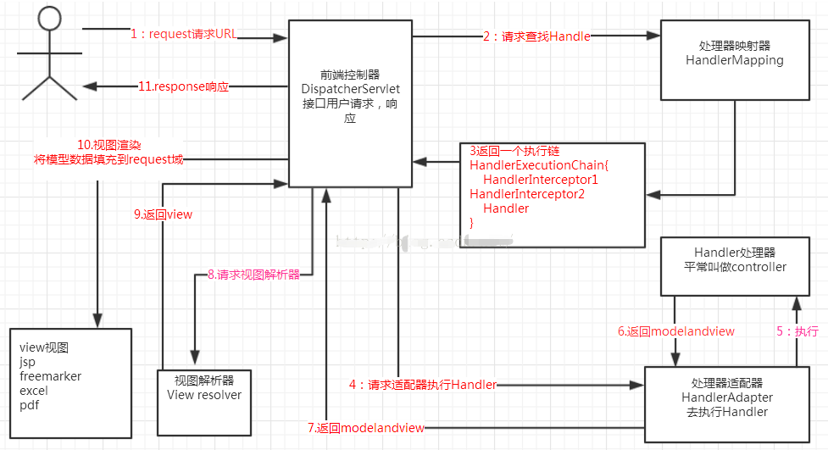
Spring MVC - Presentation Layer
Notes:
步驟描述
(1)、發起請求到前端控制器 DispatcherServlet;
(2)、前端控制器請求 HandlerMapping查詢, Handler可以根據 xml配置、註解進行查詢;
(3)、處理器對映器 HandlerMapping向前端控制器返回 Handler;
(4)、前端控制器呼叫處理器介面卡去執行 Handler;
(5)、處理器介面卡去執行 Handler ;
(6)、 Handler執行完成給介面卡返回 ModelAndView ;
(7)、處理器介面卡向前端控制器返回 ModelAndView, ModelAndView是 springmvc框架的一個底層物件,包括 Model和 view;
(8)、前端控制器請求檢視解析器去進行檢視解析，根據邏輯檢視名解析成真正的檢視 ;
(9)、檢視解析器向前端控制器返回 View ;
(10)、前端控制器進行檢視渲染,檢視渲染將模型資料(在 ModelAndView物件中)填充到 request域中;
(11)、前端控制器向使用者響應結果 ;

Slide 9
Reference
A Comparison Between Spring and Spring Boot
SpringMvc框架簡介
Spring Boot 2.0 — Project Structure and Best Practices
(Part 1)
(Part 2)
Spring Framework

